Slide 1
Patient 2- Alzheimer’s Disease
Diagnosed by: Grace Bush and Samantha Klee

Slide 2
Patient Information: Personal and Symptoms
Patient Information (DO NOT SHARE):
Mark Snow
Male
Age 78
Primary Caretaker: Daughter
No previous medical history
Main complaint:
Long and short term memory loss
Symptoms Shown:
Long term memory loss (forgetting names of relatives)
Trouble controlling emotions
Short term memory loss (Claims he has already done stuff that he has not, ex: shower)
Misplacing items
Notes:
Grace

Slide 3
Alzheimer's Diagnosis and Tests
From these symptoms, common in early Alzheimer's patients, we determined Mark Snow has Alzheimer’s disease after performing a few tests.
Common tests in diagnosing Alzheimer's include:
Magnetic Resonance Imaging (MRI)- see the areas of brain affected (Parietal, Frontal, and Temporal)
Computed Tomography (CT)- shows loss of brain mass in regions
Positron Emission Tomography (PET)- reveal images based on blood flow, oxygen levels, and glucose use that narrow down the diagnosis
Mini-Mental State Exam (MMSE)- questions of everyday mental skills
Notes:
Samantha

Slide 4
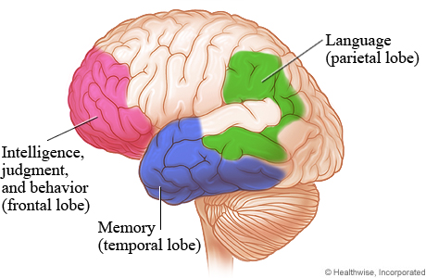
Areas of the Brain Affected
Alzheimer's disease is a form of dementia that causes neurons in the brain to not function properly. One or more “machines” in the “factory” of the brain default, affecting mood, language, and largely, memory.
Areas of the brain affected:
Frontal Lobe and Hippocampus- Long and Short term memory
Frontal Lobe- Intelligence and Behavior
Notes:
Grace

Slide 5
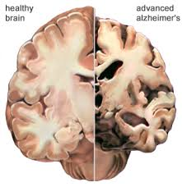
Communication Error
The disease causes the neurons is the brain to deposit and build up protein, beta-amyloid and tau, between and inside the cells.
These deposits build up to leave plague and tangles in the brain.
Plaque and tangles leave little room for the neurons to communicate with each other, causing cells to die.
Notes:
Grace

Slide 6
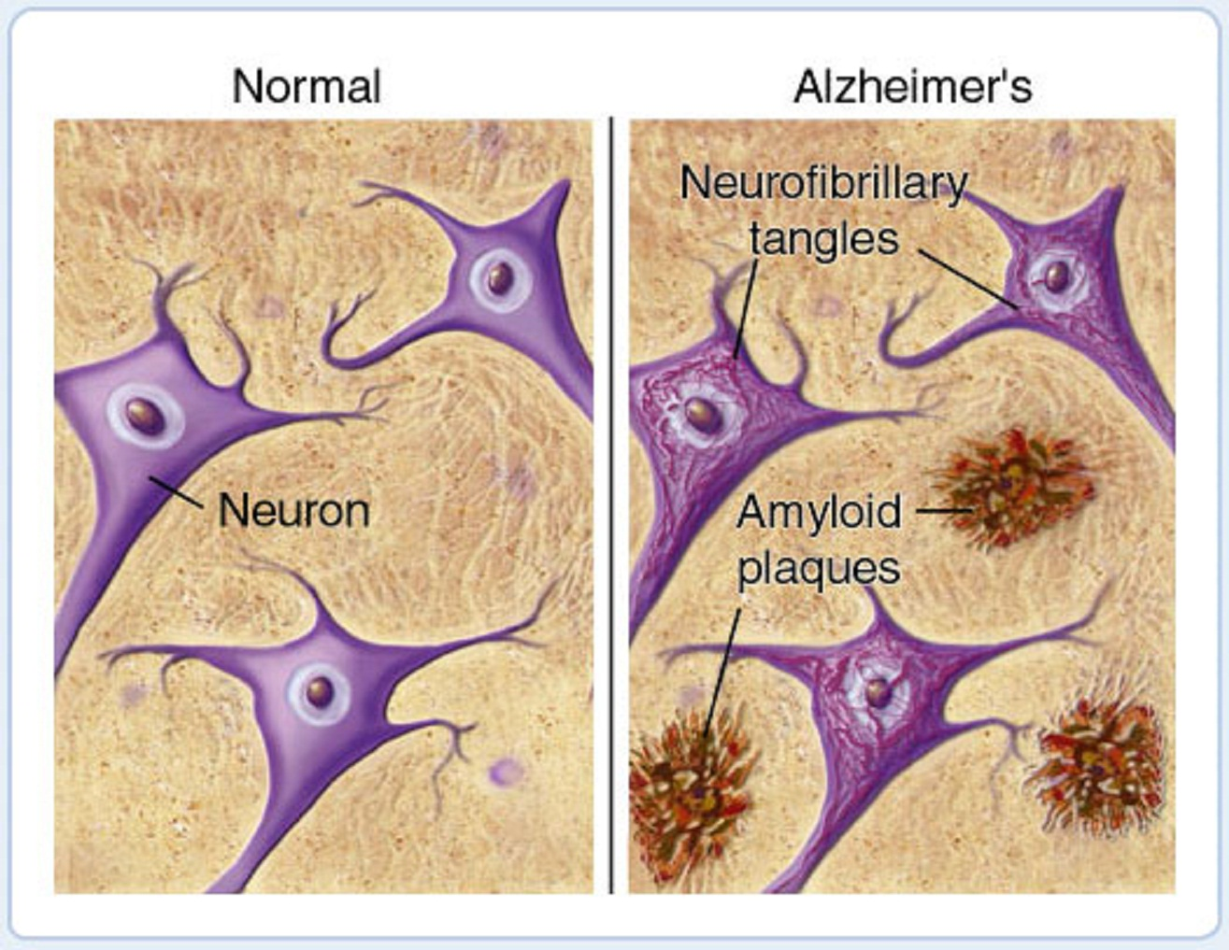
Buildup and deposits of protein limit the function of the neurons to communicate.

Slide 7
Prognosis - How Alzheimer's Affects the Future
No cure at this time.
Medications available to assist with day to day activities
Average life expectancy after diagnosis: 4-8 years
Symptoms worsen- Three phases (mild, moderate, and severe)
Severe phase symptoms- lose awareness of surroundings, changes in physical abilities, difficulty communicating, and vulnerability to infections
Die of medical complications, such as pneumonia, or when a body system shuts down.
Notes:
Samantha

Slide 8
We Need Your Help: Geriatrician
WHAT IS A GERIATRICIAN?
A geriatrician is a medical doctor who specializes in the care of older adults and diseases common at an older age.
BENEFITS:
Most knowledgeable on the care of Alzheimer's patients.
Works closely with a caregiving team to provide the best care possible.
Notes:
Grace

Slide 9
We Need Your Help: Neuropsychologist
WHAT IS A NEUROPSYCHOLOGIST?
A neuropsychologist is a psychologist that specializes in understanding how the physical brain relates to behavior.
BENEFITS:
Identify early behavioral symptoms of Alzheimer’s.
Often work with neurologists to assess a treatment specific to patient.
Notes:
Samatha

